Slide 1


Slide 2
Sendai Chapter Aug. 2016 – July 2017
Officers
Chair- Masahiro Yamaguchi Tohoku University
Vice Chair- Ken Kawamata Tohoku Gakuin University
Secretary- Teruo Tobana Akita Prefectural University
Treasurer- Yu-Ichi Hayashi Tohoku Gakuin University (-March 2017)
Shinobu Ishigami Tohoku Gakuin University (April 2017-)
Number of Members
20 (2016)

Slide 3
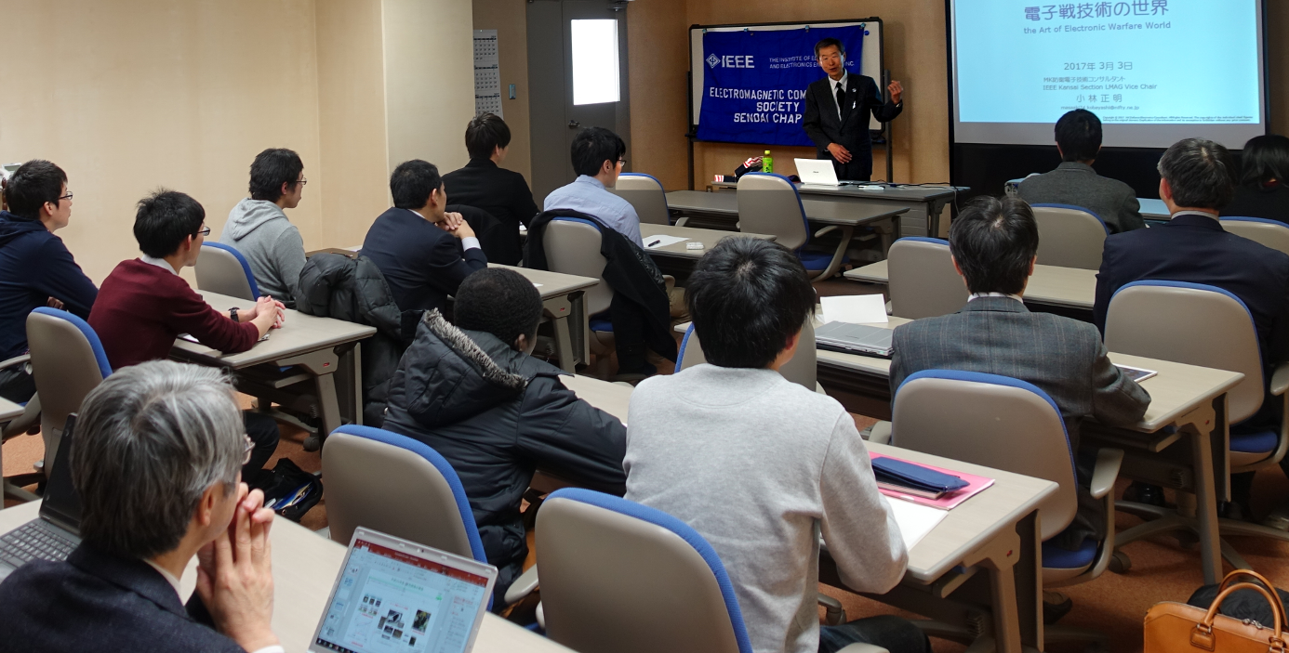
Sponsored Events
Kenji Araki, Sony EMCS Corp.
Noise Coupling Path Analysis for RF Interference Caused by LCD Noise Modulation
2016 Japan Joint/Sendai Chapter Meeting
- 2016 EMC Symposium Report
- 6 Activity Reports
(12/06/2016)
Masaaki Kobayashi, M.K. Consultant
The Art of Electronic Warfare World
Sendai Chapter Colloquium
(3/4/2017)
Lecture by Masaaki Kobayashi

Slide 4
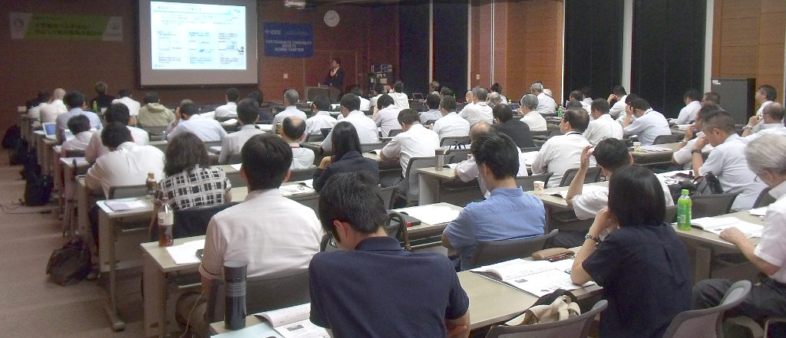
Co-Sponsored Events
October EMCJ Meeting
27 talks, 107 attendees in two days
w/ EMCJ of IEICE Communications Society
(10/20-21/2016)
Seiichi Sampei, Osaka University
Future social structure revolutionized with progress of 5G
Extreme Environment Electromagnetic Wave Sensing WS, 48 attendees
(2/14/2017)
Radio wave environment improvement technology corresponding to broadening band-width unwanted radio waves WS
2 plenary talks, 7 regular talks, 92 attendees
(7/13/2017)

Slide 5
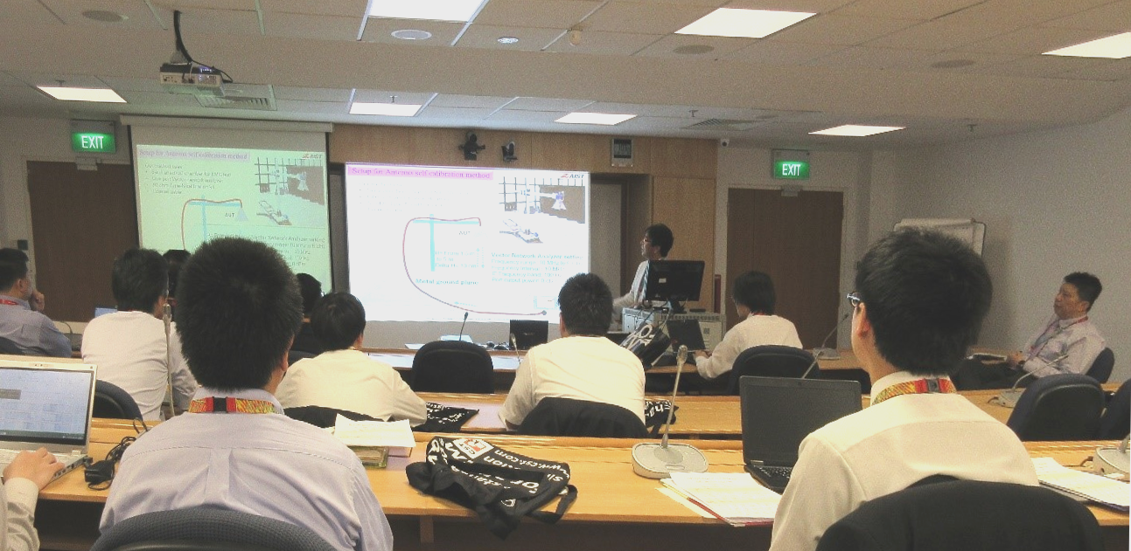
Supported Events
10 EMCJ Meetings
w/ EMCJ of IEICE Communications Society
104 talks, including;
EMC Joint Workshop 2017, Singapore
Nanyang Technological University, Singapore
23 talks (5/18-19/2017)
Technical Meeting on Magnetics
w/ Technical Committee on Magnetics, IEE of Japan
7 talks (7/14/2017)
Tasuku Takagi, Emeritus Professor, Tohoku University
Reminiscence of EMC activities in Japan
w/ EMC Sendai Seminar, Tohoku University
(10/21/2016)

Slide 6
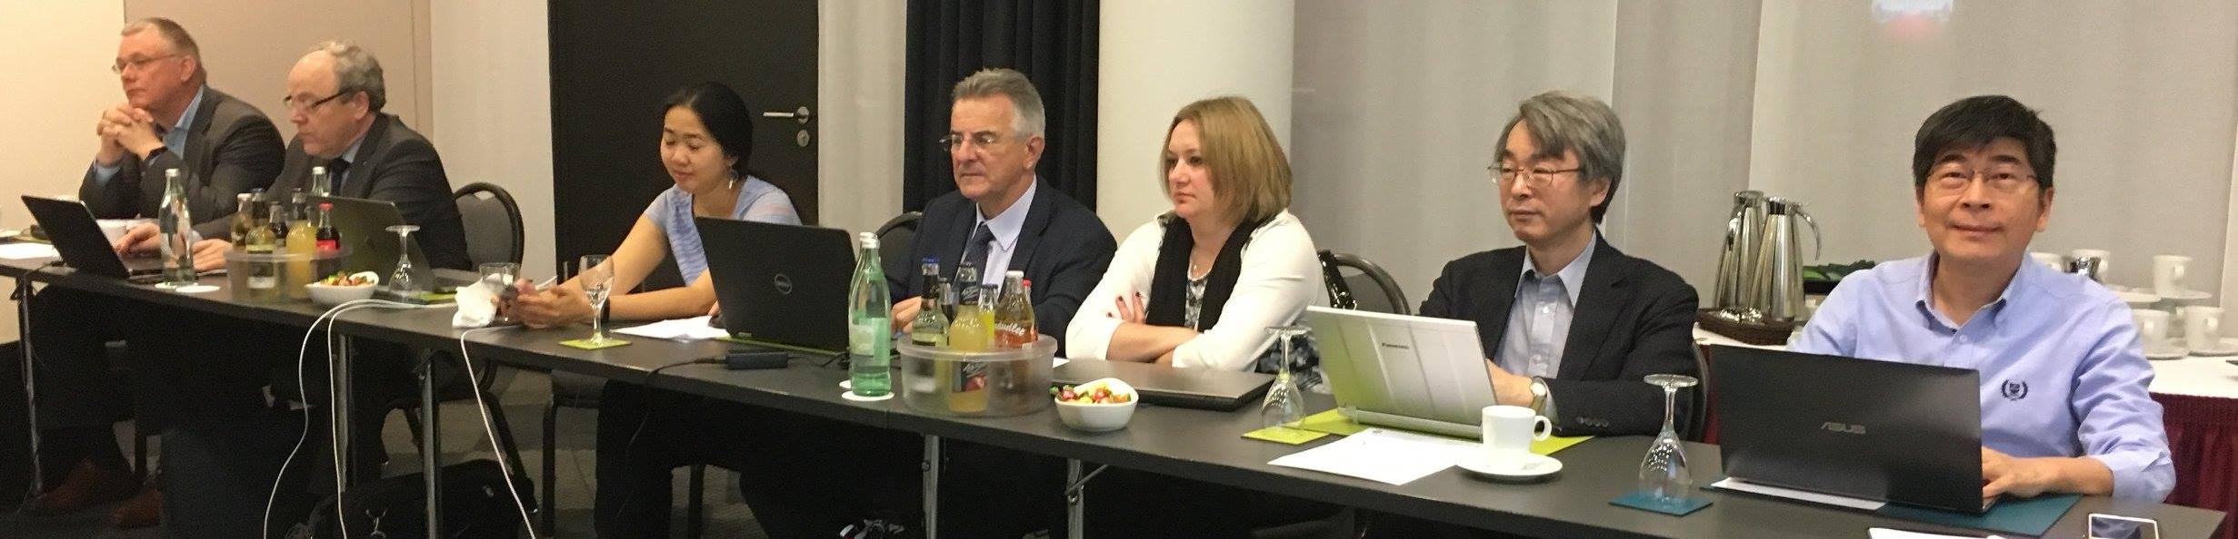
Non Technical Events
2 Chapter Officer Meetings
Chapter sponsoring, co-sponsoring and supporting event planning,
3/3/2017, 5/18/2017, and online meetings
Guest attendance to the IEEE EMC Society Board of Directors Meeting
Chapter chair attended the meeting to learn more about the EMC society.
(3/27-28/2017)

